Slide 1
Exercise 1
The standard deviation of measurements at low level for a method for detecting benzene in blood is 52 ng/L.
What is the Critical Level if we use a 1% probability criterion?
What is the Minimum Detectable Value?
If we can use 52 ng/L as the standard deviation, what is a 95% confidence interval for the true concentration if the measured concentration is 175 ng/L?
If the CV at high levels is 12%, about what is the standard deviation at high levels for the natural log measured concentration? Find a 95% confidence interval for the concentration if the measured concentration is 1850 ng/L?

Slide 3
Exercise 2
Download data on measurement of zinc in water by ICP/MS (“Zinc.csv”). Use read.csv() to load.
Conduct a regression analysis in which you predict peak area from concentration
Which of the usual regression assumptions appears to be satisfied and which do not?
What would the estimated concentration be if the peak area of a new sample was 1850?
From the blanks part of the data, how big should a result be to indicate the presence of zinc with some degree of certainty?
Try using weighted least squares for a better estimate of the calibration curve. Does it seem to make a difference?

Slide 4
zinc <- read.csv("zinc.csv")
> names(zinc)
[1] "Concentration" "Peak.Area"
> zinc.lm <- lm(Peak.Area ~ Concentration,data=zinc)
> summary(zinc.lm)
Call:
lm(formula = Peak.Area ~ Concentration, data = zinc)
Residuals:
Min 1Q Median 3Q Max
-11242.22 -82.01 333.28 485.89 9353.28
Coefficients:
Estimate Std. Error t value Pr(>|t|)
(Intercept) 104.5429 267.1370 0.391 0.696
Concentration 7.2080 0.0307 234.769 <2e-16 ***
---
Signif. codes: 0 ‘***’ 0.001 ‘**’ 0.01 ‘*’ 0.05 ‘.’ 0.1 ‘ ’ 1
Residual standard error: 2201 on 89 degrees of freedom
Multiple R-squared: 0.9984, Adjusted R-squared: 0.9984
F-statistic: 5.512e+04 on 1 and 89 DF, p-value: < 2.2e-16
> plot(zinc$Concentration,zinc$Peak.Area)
> abline(coef(zinc.lm))
> plot(fitted(zinc.lm),resid(zinc.lm))
> (1850-104.5429)/7.2080
[1] 242.1555

Slide 5
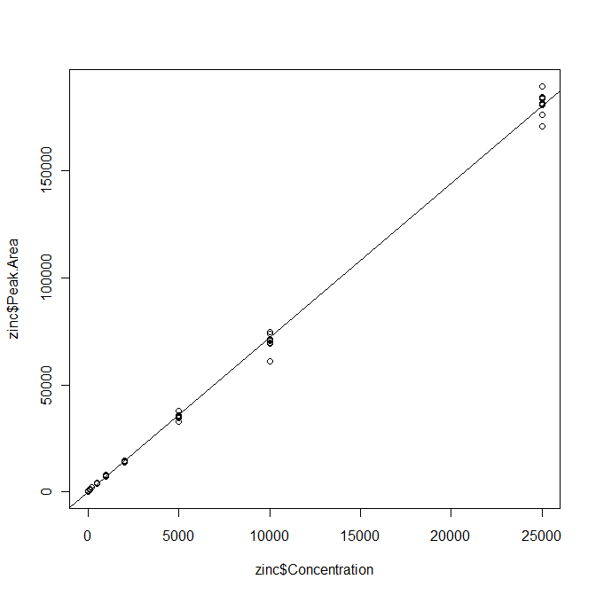

Slide 6
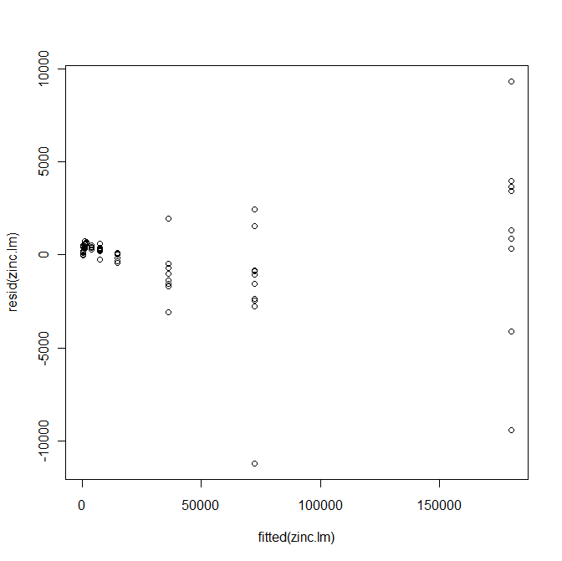

Slide 7
> zinc[zinc$Concentration==0,]
Concentration Peak.Area
1 0 115
2 0 631
3 0 508
4 0 317
5 0 220
6 0 93
7 0 99
8 0 135
> mean(zinc[zinc$Concentration==0,2])
[1] 264.75
> sd(zinc[zinc$Concentration==0,2])
[1] 205.0343
264.75+2.326*205.3
[1] 742.2778
The CL in peak area terms is 742, with
zero concentration indicated at 265.
The CL in ppt is
(742 − 104.5429)/7.2080 = 88 ppt.
The MDV is 176 ppt.
No samples for true concentrations of
0, 10, or 20 had peak areas above the CL.
For the samples at 100ppt or above,
all had peak areas above the CL of 742.

Slide 8
> summary(lm(Peak.Area ~ Concentration,data=zinc))
Coefficients:
Estimate Std. Error t value Pr(>|t|)
(Intercept) 104.5429 267.1370 0.391 0.696
Concentration 7.2080 0.0307 234.769 <2e-16 ***
> vars <- tapply(zinc$Peak,zinc$Conc,var)
0 10 20 100 200 500 1000
4.203907e+04 1.714762e+02 7.869524e+02 1.438745e+04 1.431810e+03 8.074238e+03 5.365478e+04
2000 5000 10000 25000
4.098095e+04 1.849742e+06 1.358443e+07 2.835566e+07
> concs <- unique(zinc$Conc)
> concnums <- table(zinc$Conc)
0 10 20 100 200 500 1000 2000 5000 10000 25000
8 7 7 11 7 7 9 7 9 10 9

Slide 9
> summary(lm(Peak.Area ~ Concentration,data=zinc))
Coefficients:
Estimate Std. Error t value Pr(>|t|)
(Intercept) 104.5429 267.1370 0.391 0.696
Concentration 7.2080 0.0307 234.769 <2e-16 ***
> vars <- tapply(zinc$Peak,zinc$Conc,var)
> concs <- unique(zinc$Conc)
> concnums <- table(zinc$Conc)
> concs2 <- concs^2
> var.lm <- lm(vars ~ concs2)
> rbind(vars,predict(var.lm))
0 10 20 100 200 500 1000 2000 5000 vars 42039.07 171.4762 786.9524 14387.45 1431.81 8074.238 53654.78 40980.95 1849742
829839.07 829843.6834 829857.5149 830300.12 831683.27 841365.323 875944.07 1014259.07 1982464
> wt1 <- 1/rep(vars,concnums)
> wt2 <- 1/rep(predict(var.lm),concnums)
> summary(lm(Peak.Area ~ Concentration,data=zinc,weights=wt1))
Coefficients:
Estimate Std. Error t value Pr(>|t|)
(Intercept) 333.9925 18.9250 17.65 <2e-16 ***
Concentration 7.4117 0.1103 67.21 <2e-16 ***
> summary(lm(Peak.Area ~ Concentration,data=zinc,weights=wt2))
Coefficients:
Estimate Std. Error t value Pr(>|t|)
(Intercept) 433.20668 91.07209 4.757 7.55e-06 ***
Concentration 7.06868 0.03555 198.864 < 2e-16 ***

Slide 10
Exercise 3
The file hiv.csv contains data on an HIV PCR assay calibration. These are dilutions of ten samples at 15 copy numbers from 25 to 20,000,000.
In theory, the Ct value (Target in the data set) should be linear in log copy number. Fit the calibration line and look at plots to examine the assumptions of linear regression.
What is the estimated copy number for an unknown if Ct = 25?
The column QS is the Ct value for an in-tube standard. Consider calibrating Ct(Target) – Ct(Standard) instead. Does this work better or not? What is a good criterion?

Slide 11
> hiv.lm <- lm(Target ~ log(Nominal),data=hiv)
> summary(hiv.lm)
Call:
lm(formula = Target ~ log(Nominal), data = hiv)
Residuals:
Min 1Q Median 3Q Max
-9.7150 -0.4416 -0.1037 0.3057 8.6227
Coefficients:
Estimate Std. Error t value Pr(>|t|)
(Intercept) 38.930434 0.061413 633.9 <2e-16 ***
log(Nominal) -1.385832 0.005831 -237.7 <2e-16 ***
---
Signif. codes: 0 ‘***’ 0.001 ‘**’ 0.01 ‘*’ 0.05 ‘.’ 0.1 ‘ ’ 1
Residual standard error: 0.8828 on 878 degrees of freedom
Multiple R-squared: 0.9847, Adjusted R-squared: 0.9847
F-statistic: 5.649e+04 on 1 and 878 DF, p-value: < 2.2e-16

Slide 12
> anova(hiv.lm)
Analysis of Variance Table
Response: Target
Df Sum Sq Mean Sq F value Pr(>F)
log(Nominal) 1 44026 44026 56489 < 2.2e-16 ***
Residuals 878 684 1
---
Signif. codes: 0 ‘***’ 0.001 ‘**’ 0.01 ‘*’ 0.05 ‘.’ 0.1 ‘ ’ 1

Slide 13
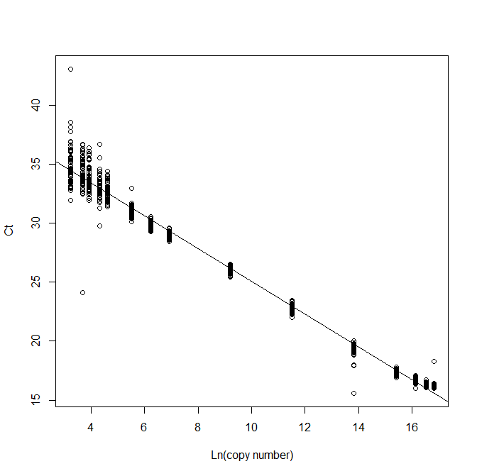

Slide 14
Calibration Results
Variance is not constant, being higher at higher Ct levels.
Adding the standard helps unless copy number is very high (more than 1 million)
Using the Target ~ regression, a Ct value of 25 corresponds to a log copy number of
(25 − 38.93)/(− 1.386) = 10.05
Copy number = exp(10.05) = 23,167

Slide 15
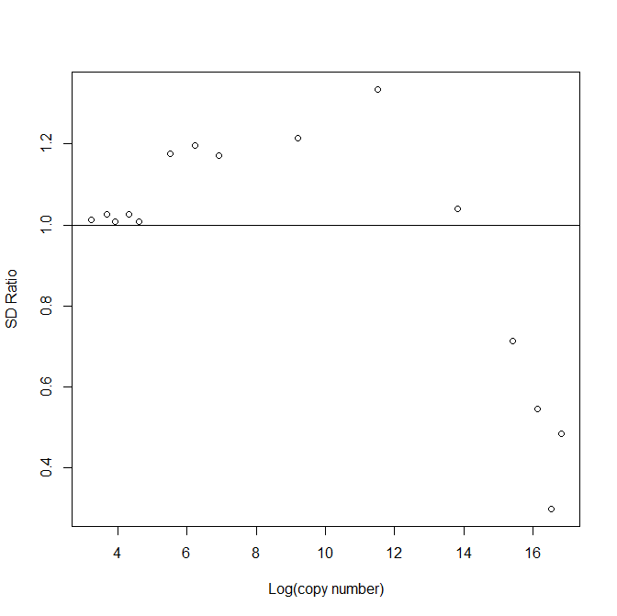
SD ratio
Target ~
vs
Target – QS ~
Use of standard
is better when copy
number > 100
and less than
5 million

Slide 16
Exercise 4
The file AD-Luminex.csv contains Luminex protein assays for 124 proteins on 104 patients who are either AD (Alzheimer's Disease, OD (other dementia) or NDC (non-demented controls).
See if the measured levels of ApoE are associated with diagnosis.
See if the measured levels of IL.1beta are associated with diagnosis.

Slide 17
> ad.data <- read.csv("AD-Luminex.csv")
> anova(lm(ApoE ~ Diagnosis,data=ad.data))
Analysis of Variance Table
Response: ApoE
Df Sum Sq Mean Sq F value Pr(>F)
Diagnosis 2 877.9 438.93 3.3662 0.03844 *
Residuals 101 13169.8 130.39
---
Signif. codes: 0 ‘***’ 0.001 ‘**’ 0.01 ‘*’ 0.05 ‘.’ 0.1 ‘ ’ 1
> anova(lm(log(ApoE) ~ Diagnosis,data=ad.data))
Analysis of Variance Table
Response: log(ApoE)
Df Sum Sq Mean Sq F value Pr(>F)
Diagnosis 2 3.1377 1.56885 6.1503 0.003016 **
Residuals 101 25.7636 0.25508
---
Signif. codes: 0 ‘***’ 0.001 ‘**’ 0.01 ‘*’ 0.05 ‘.’ 0.1 ‘ ’ 1

Slide 18
> anova(lm(IL.1beta ~ Diagnosis,data=ad.data))
Analysis of Variance Table
Response: IL.1beta
Df Sum Sq Mean Sq F value Pr(>F)
Diagnosis 2 15.20 7.5992 1.0918 0.3395
Residuals 101 702.97 6.9601
> anova(lm(log(IL.1beta) ~ Diagnosis,data=ad.data))
Analysis of Variance Table
Response: log(IL.1beta)
Df Sum Sq Mean Sq F value Pr(>F)
Diagnosis 2 1.861 0.93033 2.5717 0.0814 .
Residuals 101 36.538 0.36176
---
Signif. codes: 0 ‘***’ 0.001 ‘**’ 0.01 ‘*’ 0.05 ‘.’ 0.1 ‘ ’ 1

Slide 19
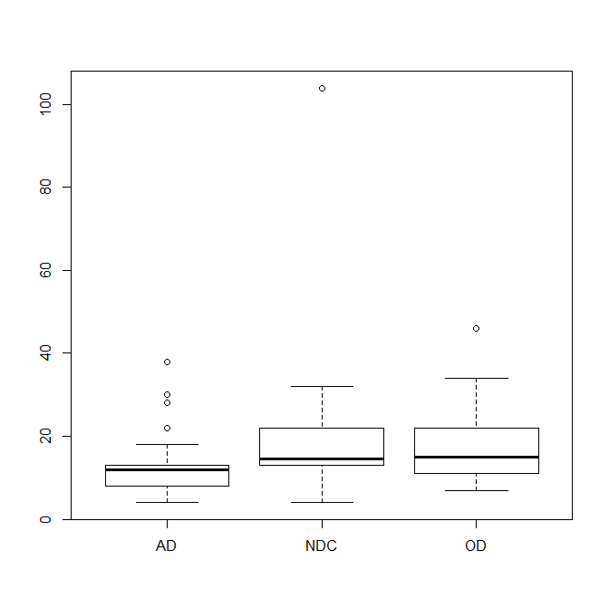

Slide 20
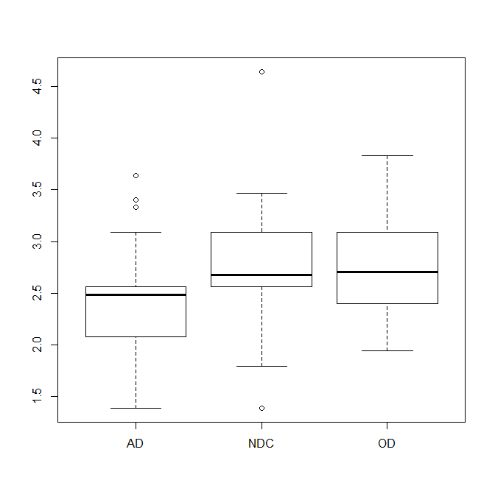

Slide 21
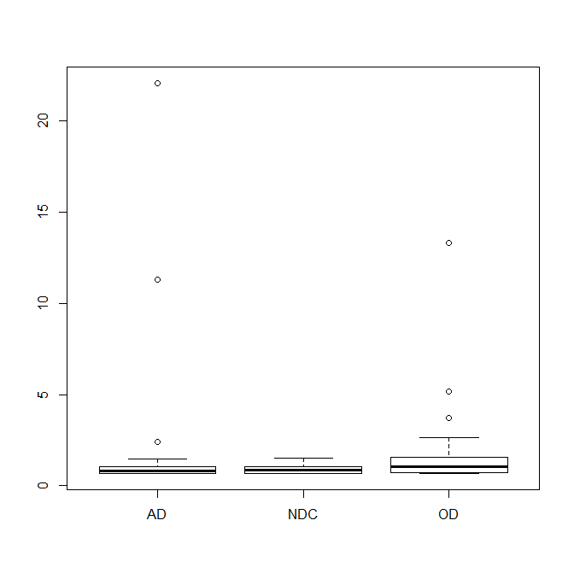

Slide 22
